Slide 1
triPOS Config Tool
Will Hakes & Eva Goins

Slide 2
Our Project
Our goal was to create a Graphical User Interface intended for use with the triPOS config file for TriPOS distributed.
This tool allows easy modification and validation of configuration parameters.

Slide 3
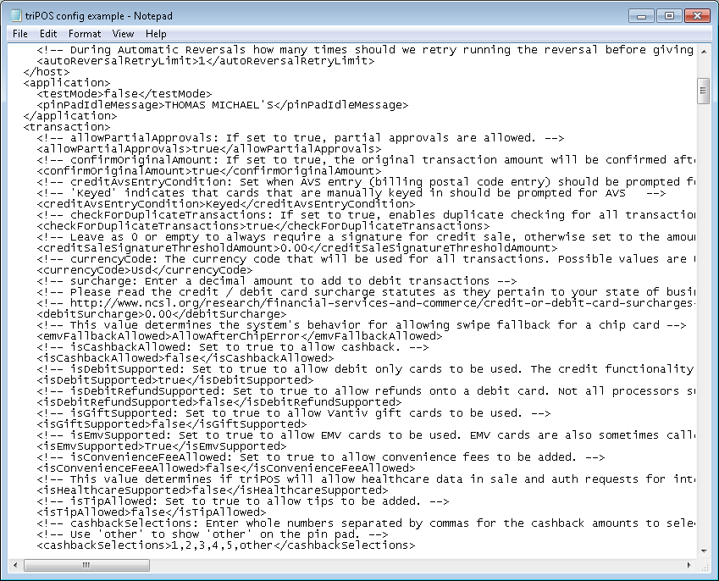
What is a triPOS Config File?
Controls a merchant’s processing configuration
Improper modification may render the merchant unable to process
Dealer, developer, or merchant should be responsible for this file.
Lives on a local PC

Slide 4
What does our tool do?
Import / Export
Validate
Possibilities
Imports XML File to local storage
Update fields
Modify fields that drive processing
Export to external file (INCOMPLETE)
On Upload
On Modify
Several methods
Text fields turn red
Labels turn red:
Check boxes
Drop Downs
Masked fields
Optional req’s
Linked field req’s
Read Only
Multiple Lanes:
Import
Export
Modify

Slide 5
Why is this important?
Merchant or dealer/ developer facing
Internal use
Exportation Possibility
Possible Additions
Readability
Notes:
-- We have a well of information we can search and get access to.
-- This file can be utilized in troubleshooting for merchants who are not able to process.
-- One of our bigger intentions with this tool is to make it accessable to merchants, dealers, and developers.
Demo the application.

Slide 6
Questions?

